Slide 1
Lake Tahoe: Journey to
Lake Clarity Crediting Program
California Regional Water Quality Control Board
Lahontan Region
Dr. Amy Horne
Lahontan Water Board Member
Robert Larsen
Environmental Scientist
18 May 2017

Slide 2
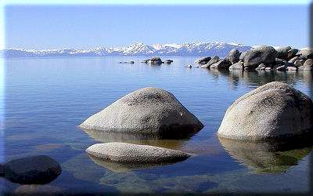
What is the Lake Tahoe TMDL?
A science-based plan to restore
Lake Tahoe’s clarity

Slide 3
Lake Tahoe TMDL Phases
Science Phase (1959 – 2010)
  What pollutants are causing clarity loss?
  How much of each pollutant reaches the lake?
  How much of each pollutant can the lake receive and still meet clarity goal?
Regulatory Strategy Phase (2005 – 2010)
  What strategy should we use to reduce pollutant loading?
  How do we regulate pollutant load reduction?
Implementation Phase (2010 – 2075?)
  Are we achieving expected reductions in pollutant loading?
  Is lake clarity improving?

Slide 4
Science Phase: 1959 - 2010
1959: Dr. Charles Goldman began monitoring lake clarity
Initial hypothesis: N, P causing clarity loss
1968: All wastewater exported from Tahoe Basin
Remaining N, P from non-point sources
2005: Scientists find new culprit: fine sediment particles (FSP)

Slide 5
What are the Sources of Nitrogen?

Slide 6
… and Phosphorus?

Slide 7
… and Fine Sediment Particles?
(particles less than 16 micrometers)

Slide 8
TMDL Science Conclusions
Two- thirds of clarity loss caused by FSP (<16 micrometers)
Total FSP Load = 481 x 10¹⁶ Particles
Need to reduce FSP load by 32% to reverse clarity loss
Urban accounts for 72% of FSP

Slide 9

Regulatory Strategy Phase
2005 - 2010
For each source category, experts quantified different options to reduce N, P, FSP loads
TMDL implementation strategy based on cost-effectiveness and feasibility

Slide 10
FSP Load Reduction Targets
34%
31%
12%
53%
Urban Atmospheric Forest Streams
Current Particle Load and Percent Reduction Target

Slide 11
Urban FSP Reduction Timeline
% FSP Load Reduction
2021 target
2016 target
Time in Years

Slide 12
Municipal NPDES
Storm Water Permit
Performance based regulation
Requires municipalities to reduce FSP as percent of 2004 baseline
Loading time step is average annual
Actions to reduce FSP also reduce N, P

Slide 13
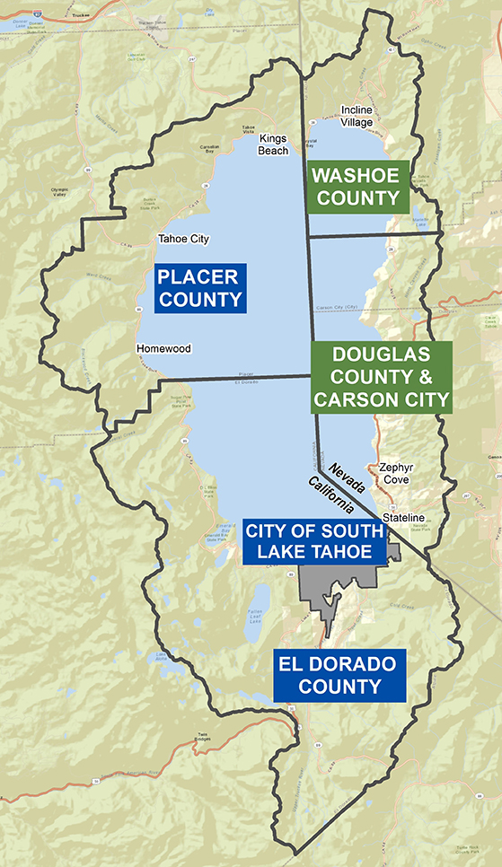
Storm Water Permittees
Placer County
El Dorado County
City of South Lake Tahoe
(CalTrans: Tahoe-specific requirements)

Slide 14

Implementation Phase
2010 – 2075?
Challenges:
Link action to expected benefits
Track progress at municipal and annual scales
Encourage jurisdictions to cooperate

Slide 15
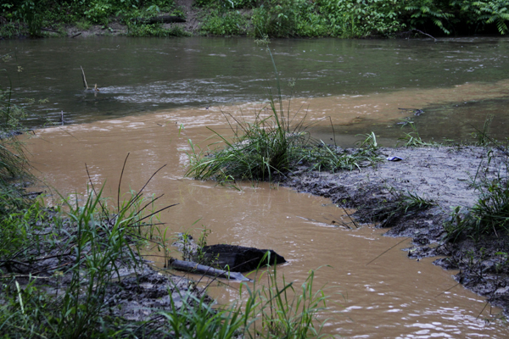
Lake Clarity Credit
Standard Metric
One Lake Clarity Credit = 1 x 10¹⁶ FSP

Slide 16
Lake Clarity Credit Targets
Minimum Number of Credits
Jurisdiction | 2016 | 2021
El Dorado | 220 √ | 342
Placer | 260 √ | 554
South Lake Tahoe | 190 √ | 521

Slide 17
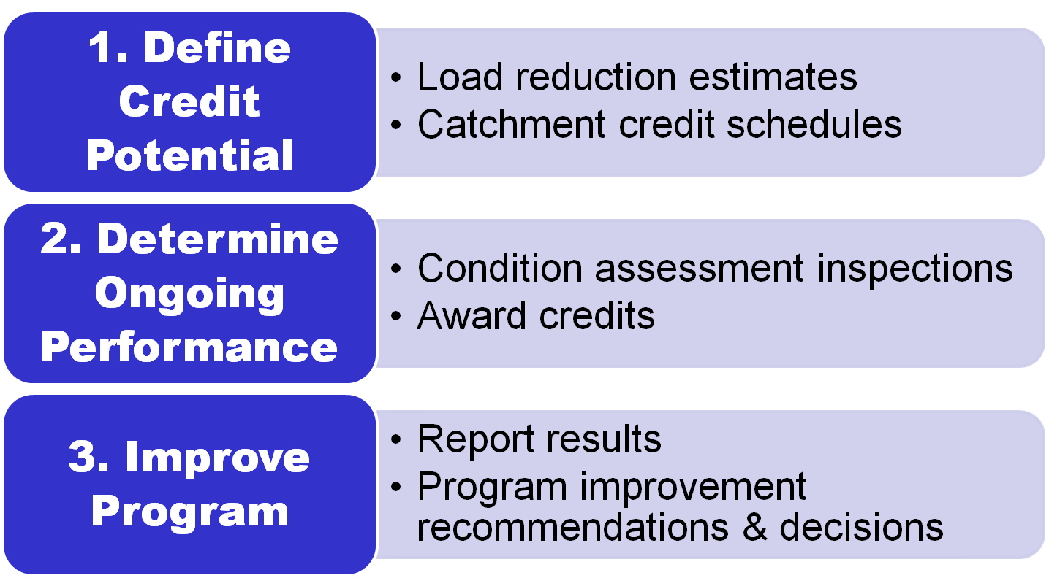
The Lake Clarity Crediting
Program Process

Slide 18

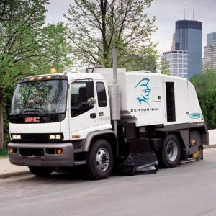
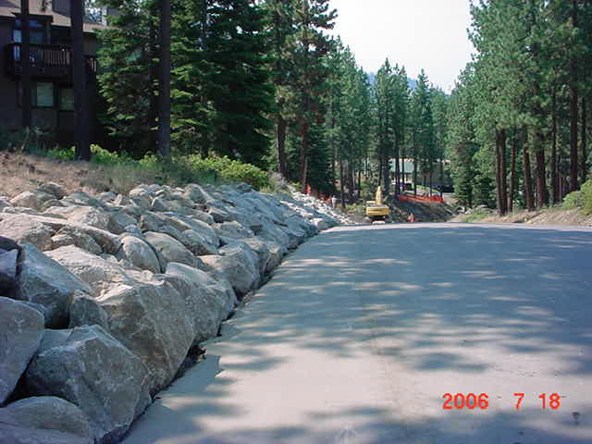
Many Ways to Earn Credits

Slide 19
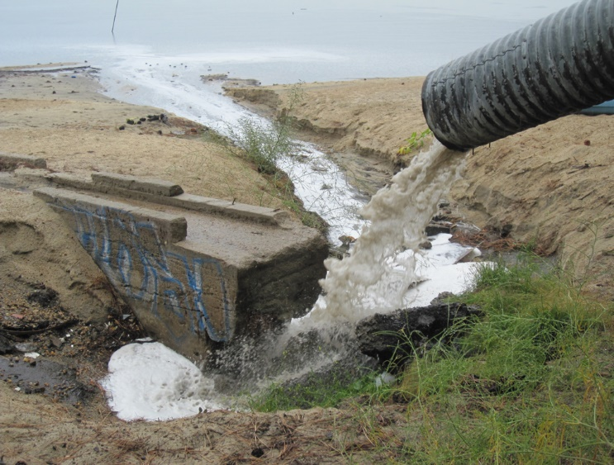
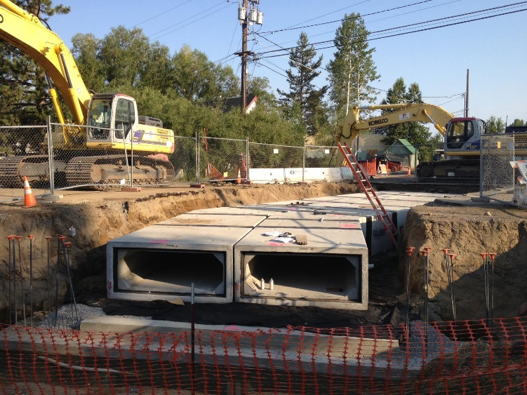
Municipality Prioritizes Actions to Earn Credits
Emphasis on surface water connectivity
Modelling tools facilitate meaningful alternatives analysis
Credit award requires demonstrated maintenance

Slide 20
Lake Clarity Crediting Program & Implementation Tools
Urban Catchment
Storm Water Treatment
Reduce Pollutant Potential
(Source Control)
Pollutant
Load
Reduction
Model
WQ Improvement Projects
Private BMPs & Muni Ordinances
Road Operations
Rapid
Assessment Methods
Maintain BMPs
Inspect & Enforce
Sand & Sweep
Accounting and Tracking Software
Notes:
20

Slide 21
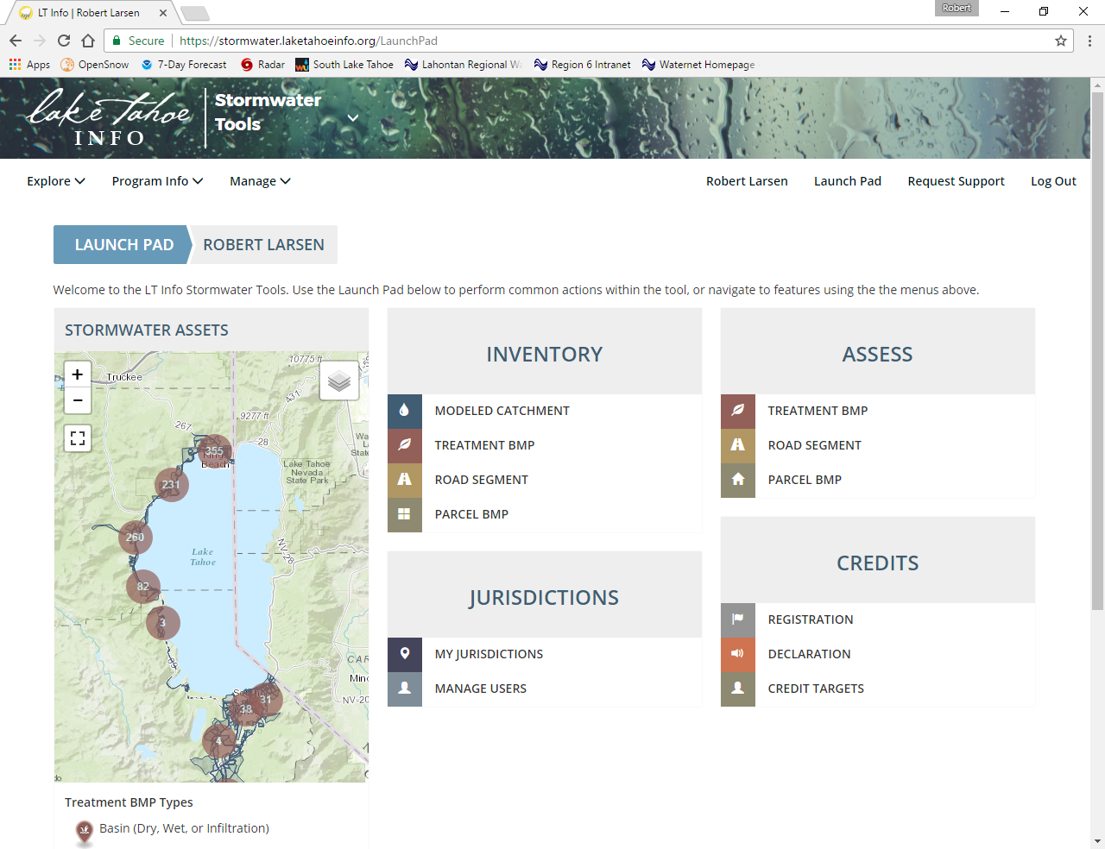
Lake Clarity Crediting Program

Slide 22
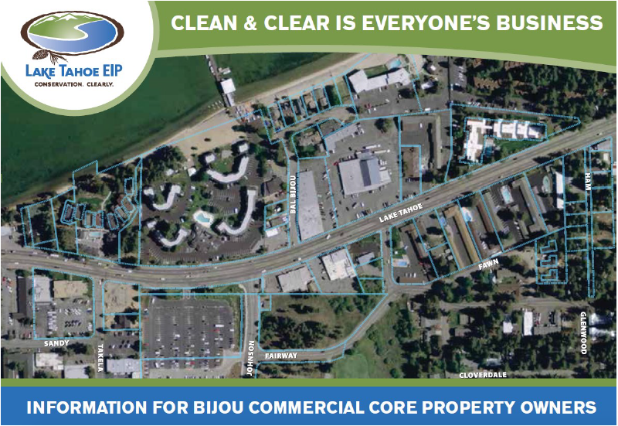
Sharing Credits Across Jurisdictions
City/CalTrans/Private Property and $$
Capital Cost >$15M
Community facilities district funds maintenance

Slide 23
LCCP Report Card
Water Board:
  Focuses municipalities on effective actions
  Creates incentives for innovation
  Links project-level actions to Lake Tahoe TMDL
Municipalities:
  Program flexibility
  Regulatory predictability
  Opportunities to cooperate

Slide 24
LCCP Report Card
Funding Agencies:
  Guidance for awarding grants
  Evaluate project effectiveness
Stakeholders:
  Most accept regulatory strategy
  Some distrust models
  Equity concern

Slide 25
LCCP Report Card
Lessons Learned:
Develop tools concurrent with policy
Provide consistency and predictability
Share risks associated with uncertainty
Continually update tools and software to incorporate new science
Regularly engage with partners to adaptively manage the program

Slide 26
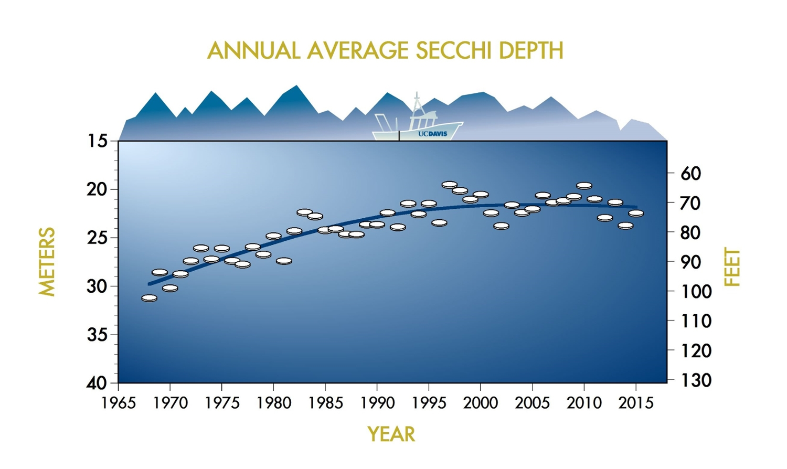
Is Lake Clarity Improving?

Slide 27

Questions?

